Slide 1
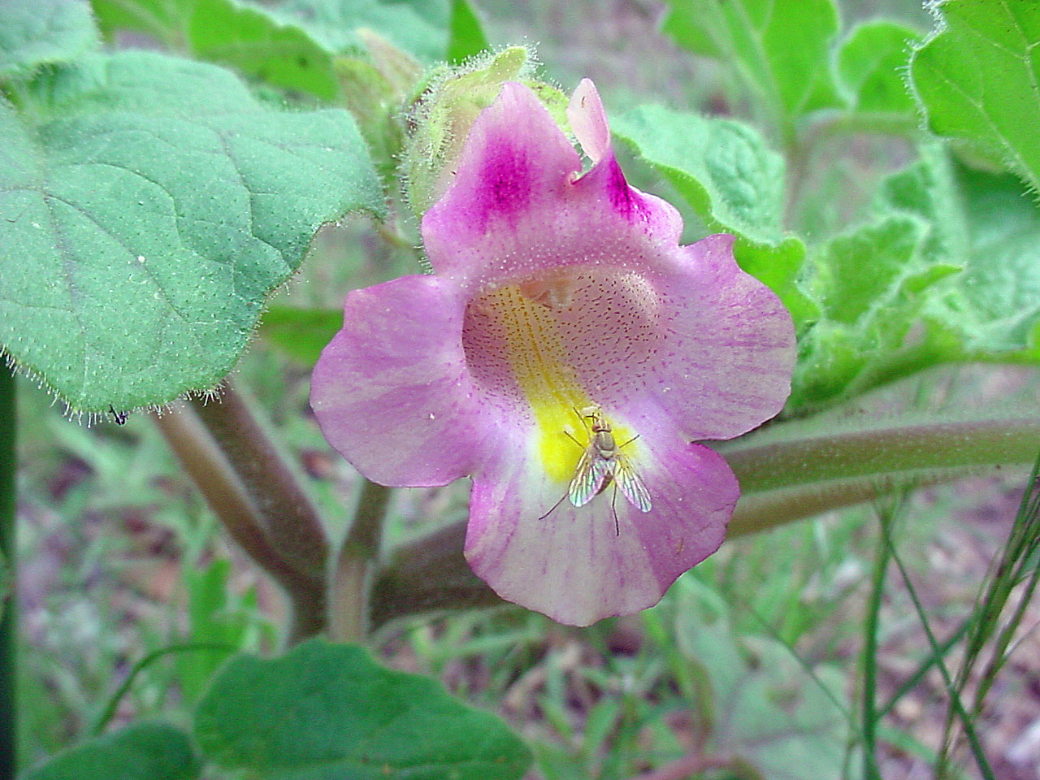
C2 C3 C4 & CAM
Variations on the
theme of photosynthesis
Proboscidea parviflora, a C4 plant

Slide 2
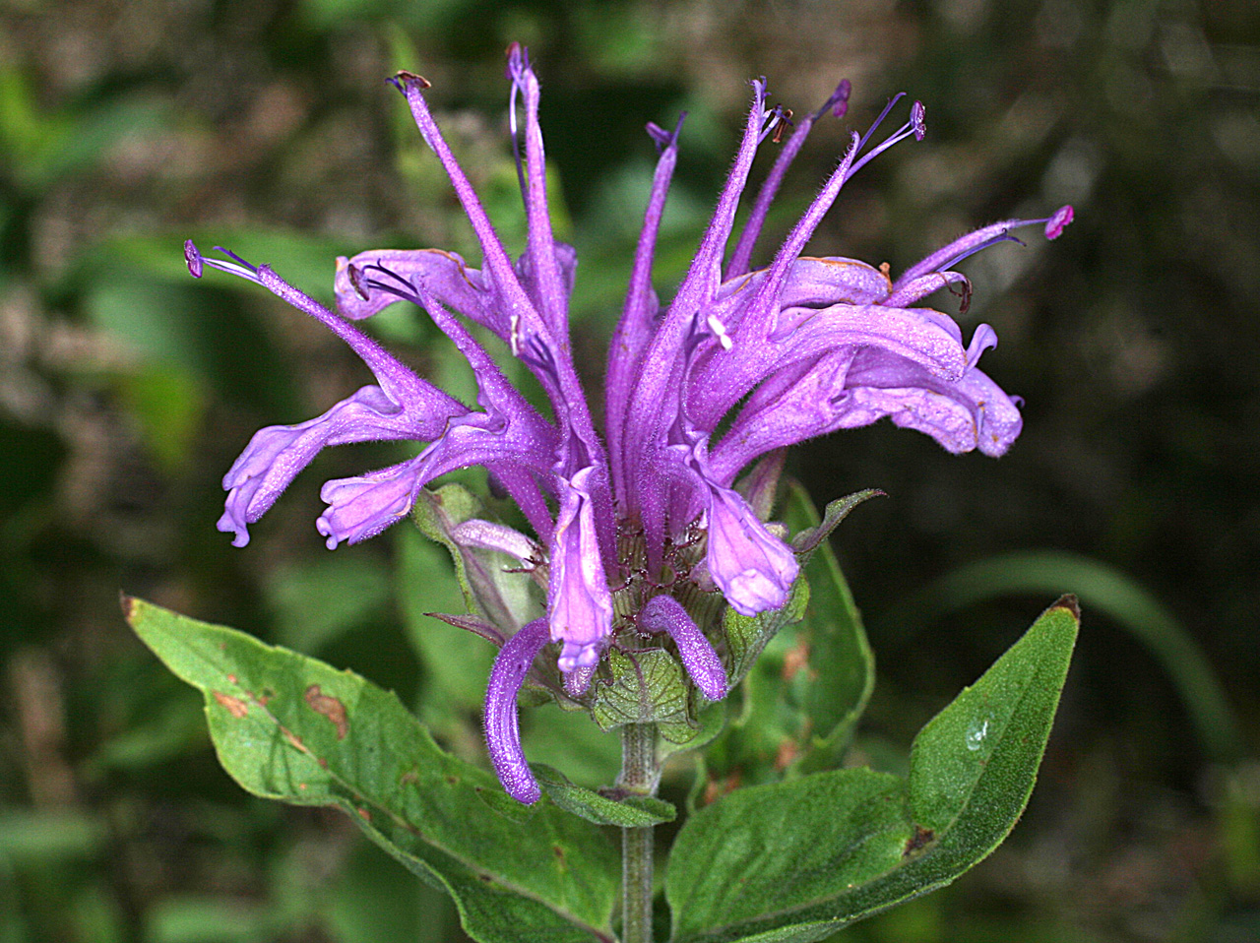
C3 Photosynthesis

Slide 3
C3 Photosynthesis (over 90% of plants)
Light reactions generate high energy molecules to run the dark reactions (Calvin cycle)
The first step of the Calvin cycle is the fixation of carbon by RUBISCO using carbon dioxide and ribulose 1,5 bisphosphate as substrates

Slide 4
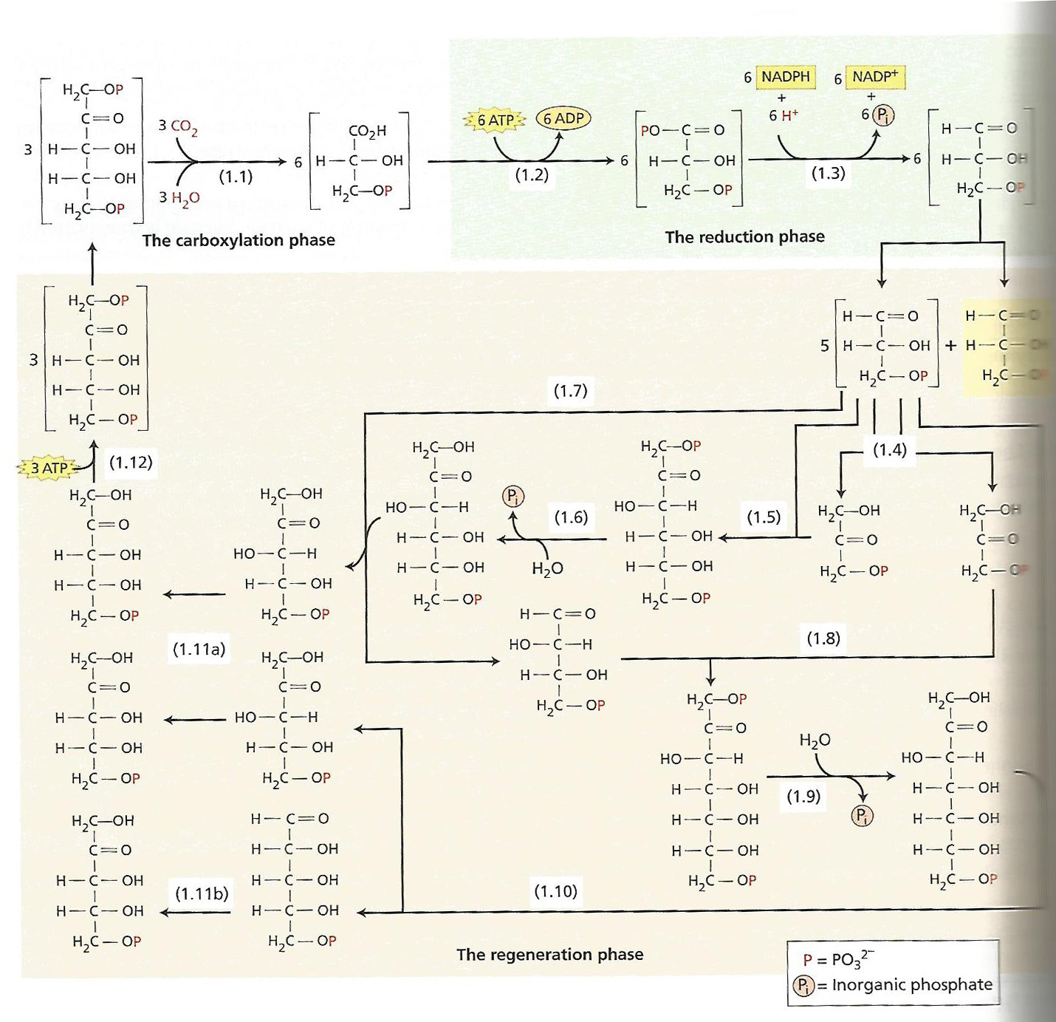
The Calvin cycle, in which 3- phosphoglycerate is formed and goes on to form sucrose for export or starch. Most though (5 of 6 molecules formed) is used for recycling into ribulose 1,5 bisphosphate. RUBISCO is the key enzyme involved in carbon fixation. All pathway slides from Taiz & Zeiger – Plant Physiology and Development 6th ed.

Slide 5
C2 Photosynthesis
RUBISCO is an ancient enzyme, and evolved when oxygenation was insignificant
With oxygenic photosynthesis and higher O2 levels in the atmosphere, oxygenation by RUBISCO became significant

Slide 6
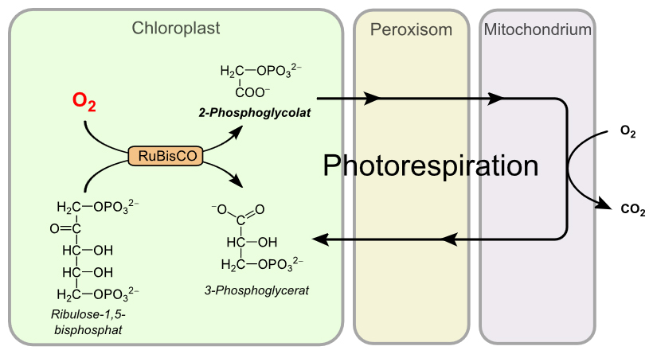
Problem is→ 2-Phosphoglycolate is toxic to plants, it inhibits distinct reactions in the Calvin Cycle. It also represents a significant loss of energy to the plant and is therefore at some cost returned to the Calvin cycle.

Slide 7
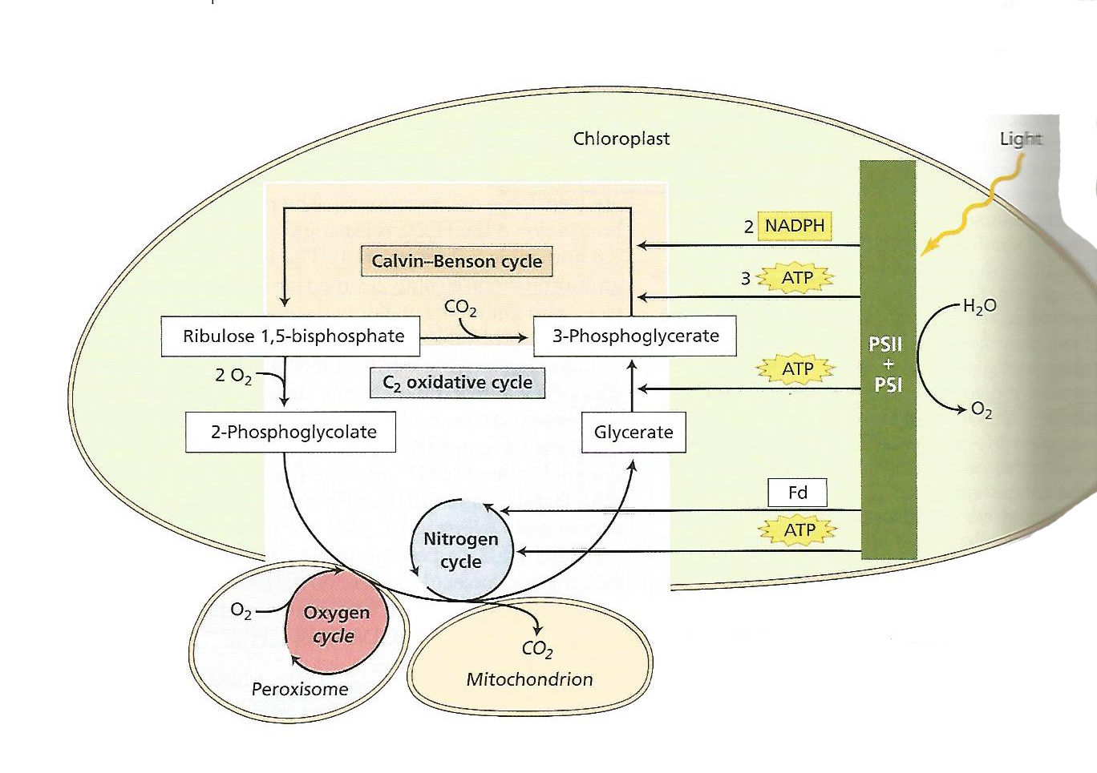
It takes energy to return 2-phosphoglycolate to the Calvin cycle

Slide 8
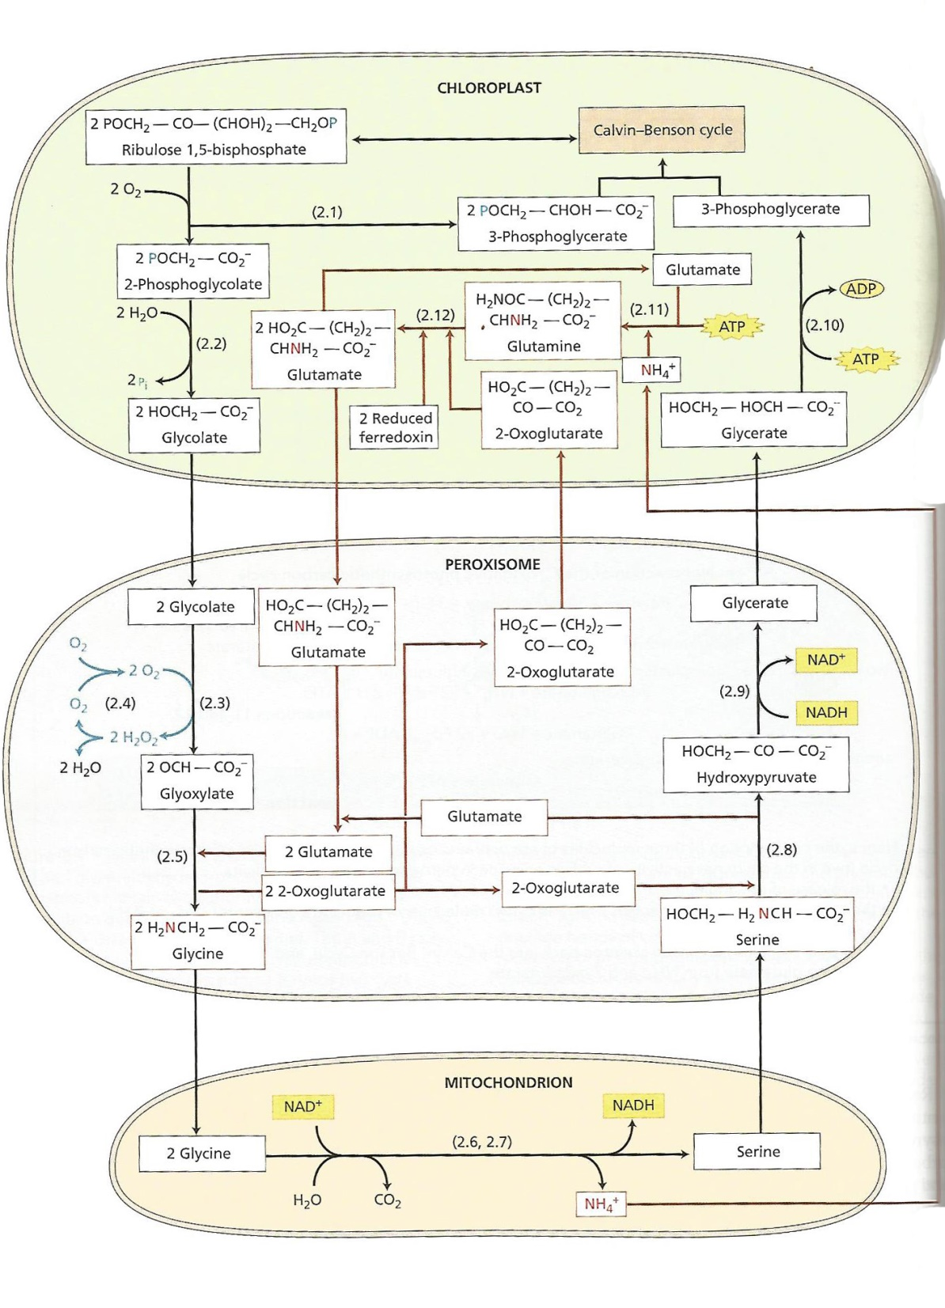
Glycolate oxidase

Slide 9
The C4 (3% of plants) and CAM pathways (5% of plants) evolved to reduce the impact of oxidation by RUBISCO (photorespiration, C2 pathway)
The C4 photosynthetic pathway concentrates CO2 in the vascular bundle sheath cells of leaves (i.e.,away from the external atmosphere) to significantly reduce competition with O2 for the active site on RUBISCO
The CAM photosynthetic pathway further separates absorption of CO2 in time from its incorporation in the Calvin cycle
C4 & CAM are more efficient than C3 at yielding energy above about 85 degrees F–Rubisco favors oxygenation the higher the temp because the concentration of CO2 in leaf tissue is less the higher the temp. Both C4 & CAM evolved in last 35 million years or so.

Slide 10
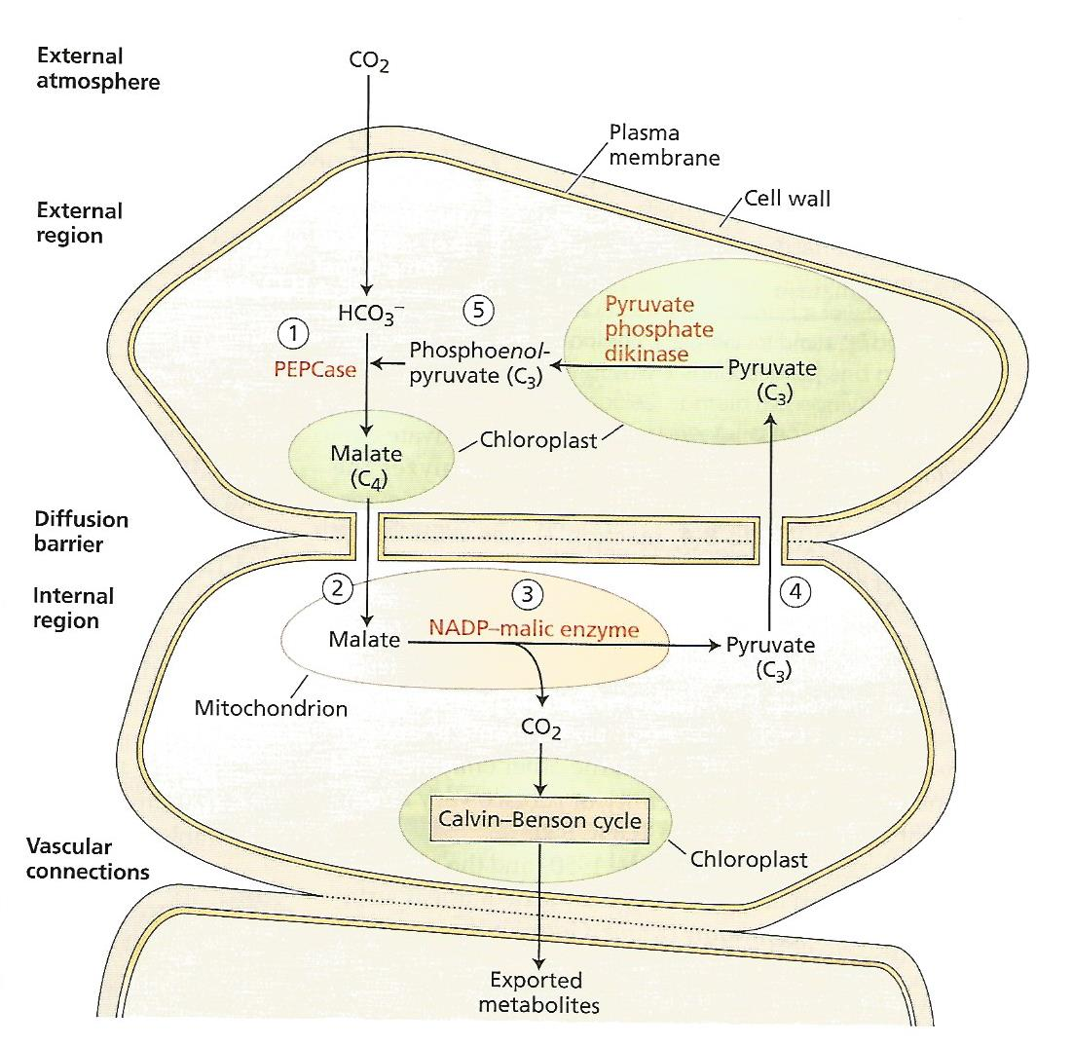
C4 Photosynthesis
Unlike RUBISCO, PEPCase is NOT inhibited by oxygen so it can function close to fix CO2 close to the external atmosphere

Slide 11
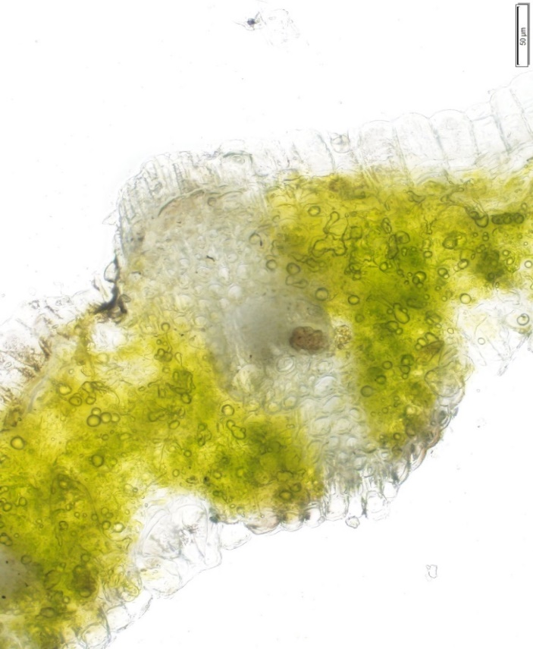
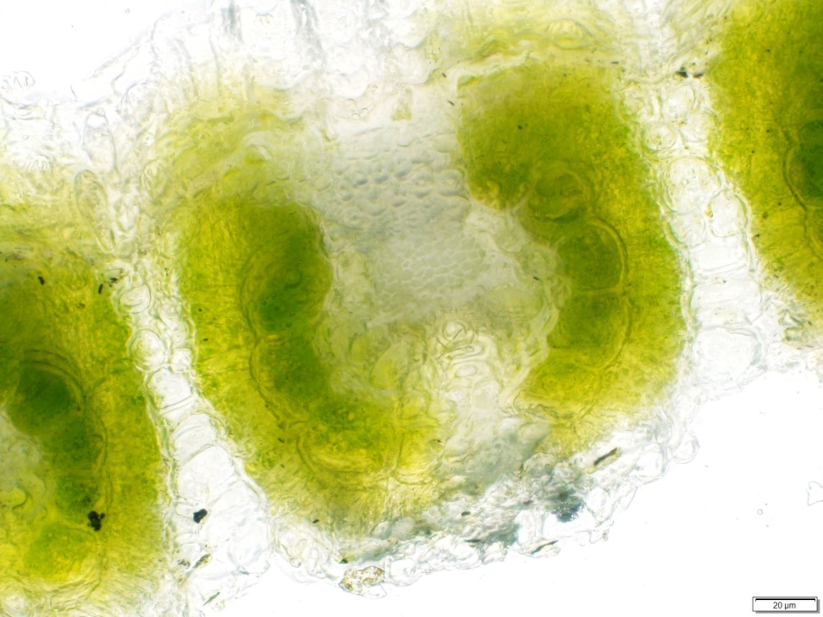
C3 & C4 Photosynthesis– Kranz Anatomy
C3– Bromus catharticus
C4– Aristida purpurea
At 86° F C4 becomes more efficient than C3 due to photorespiration. The starch rich chloroplasts of the Kranz anatomy lack grana, the site of the light reactions. They differ from the chloroplasts of the outer bundle sheath (dimorphic chloroplasts).

Slide 12
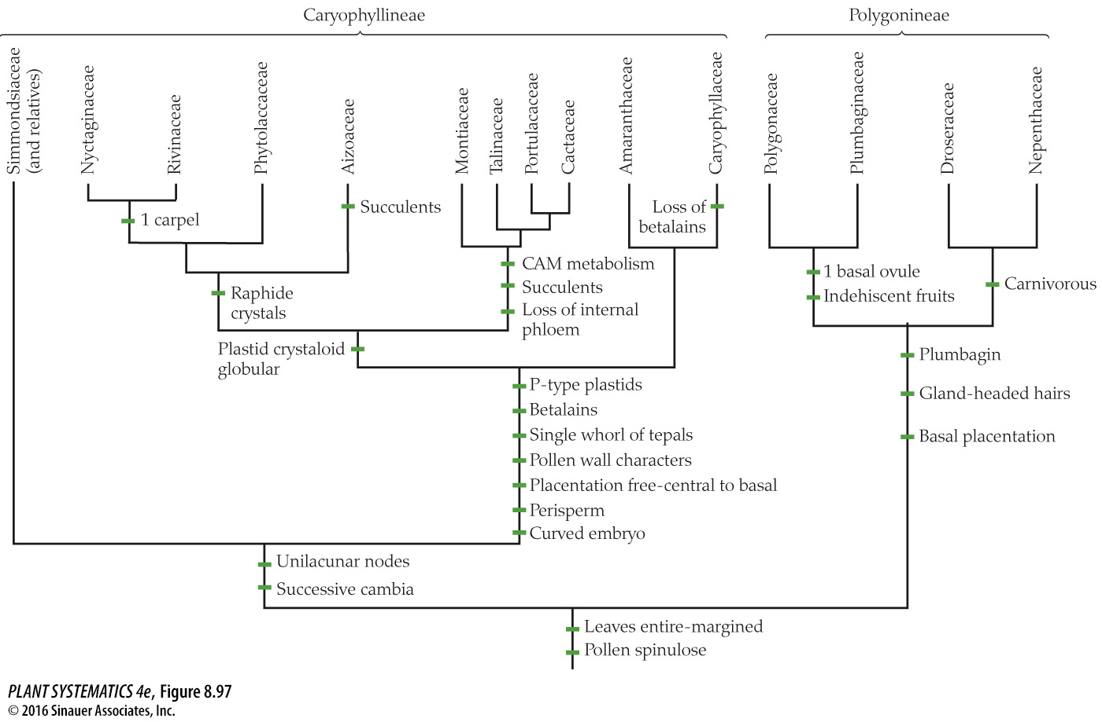
Caryophyllales

Slide 13
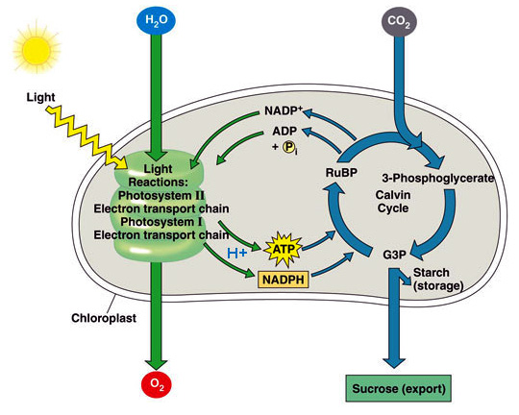
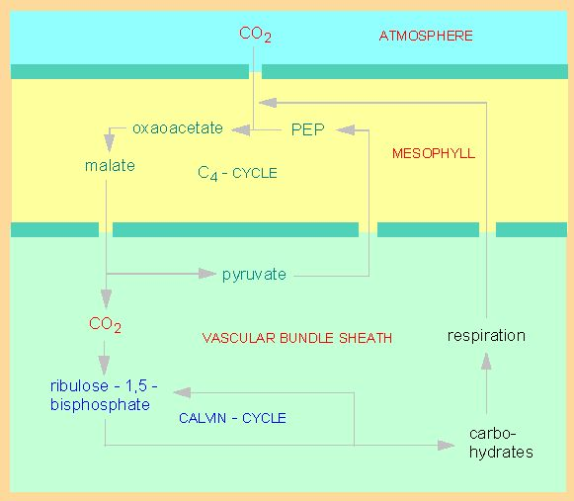
Some Grasses use the C3 photosynthetic pathway (cool season grasses) and some use the C4 pathway (warm season grasses)
C3 pathway
C4 pathway

Slide 14
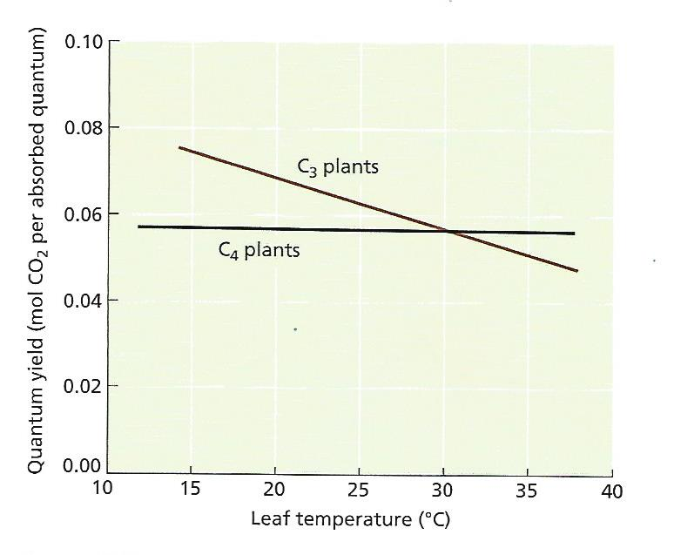

Slide 15
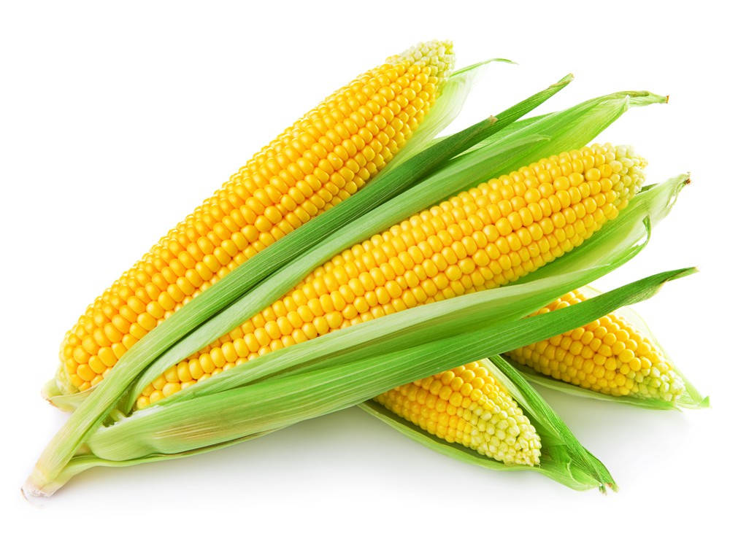

Slide 16
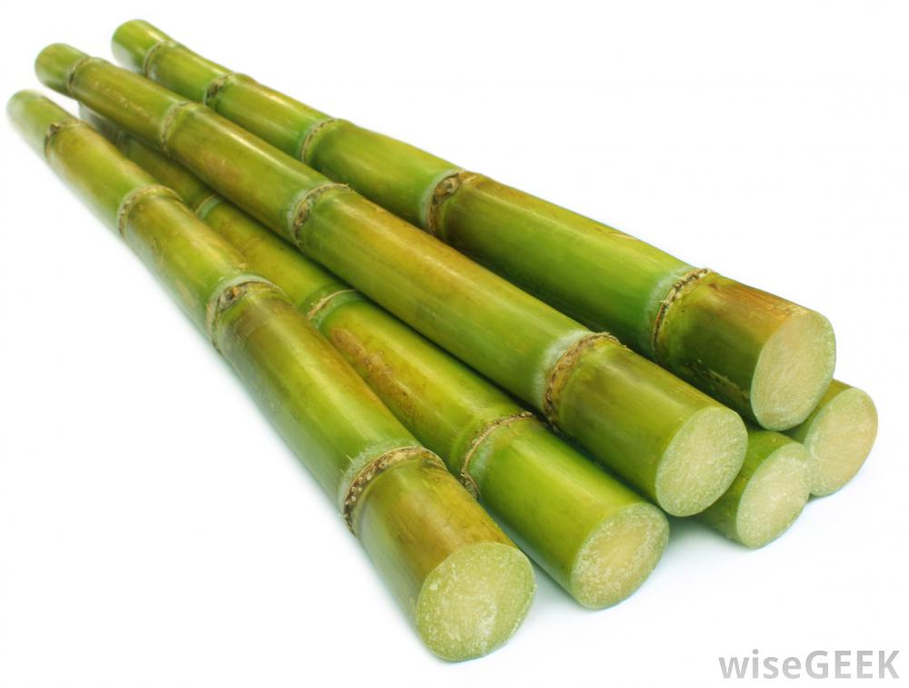

Slide 17
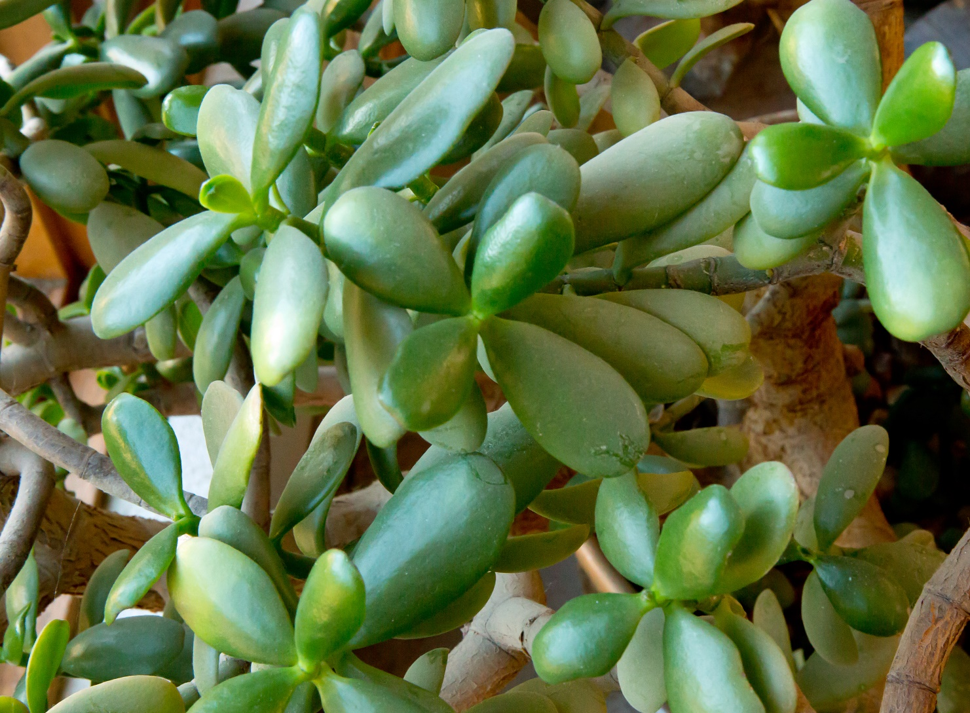
CAM (Crassulacean Acid Metabolism) Photosynthesis

Slide 18
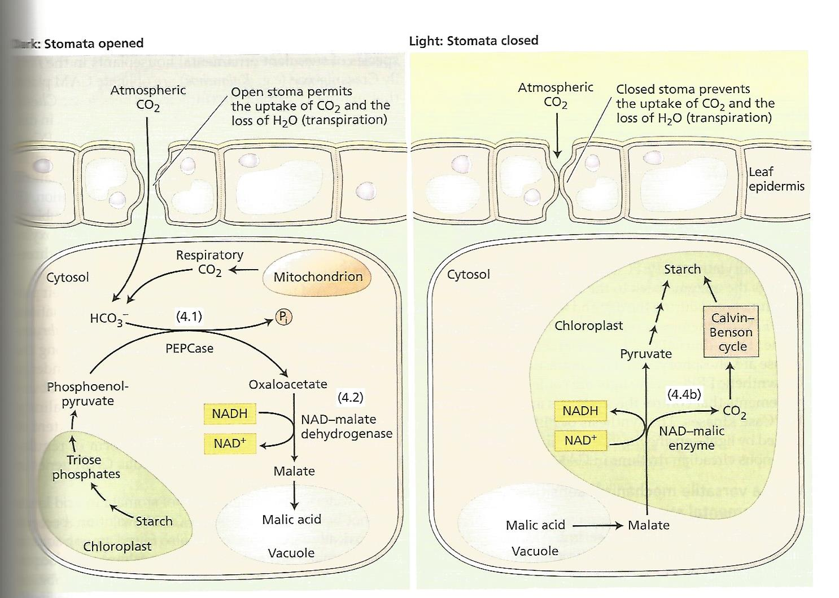
CAM Photosynthesis

Slide 19
CAM Photosynthesis
In addition to being more efficient like C4 at higher temperatures by avoiding photorespiration, CAM conserves water by allowing stomata to be closed during the heat of the day to conserve water

Slide 20
“Since every CO2 molecule has to be fixed twice, first by 4-carbon organic acid and second by RuBisCO, the C4 pathway uses more energy than the C3 pathway. The C3 pathway requires 18 molecules of ATP for the synthesis of one molecule of glucose, whereas the C4 pathway requires 30 molecules of ATP. This energy debt is more than paid for by avoiding losing more than half of photosynthetic carbon in photorespiration as occurs in some tropical plants, making it an adaptive mechanism for minimizing the loss.”
--quoted from that ubiquitous source, Wikipedia

